Slide 1
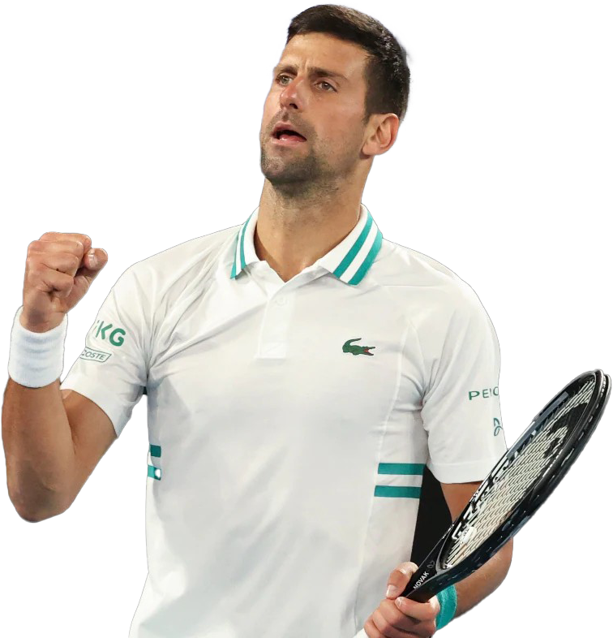
TENNIS
Analysis

Slide 2


We retrieved by scraping the information about matches of the OPEN tournaments in the last 10 years
We retrieved by scraping the top 100 rankings for the last 10 years in the month before every OPEN tournament, as well as the general information about every player

Slide 3
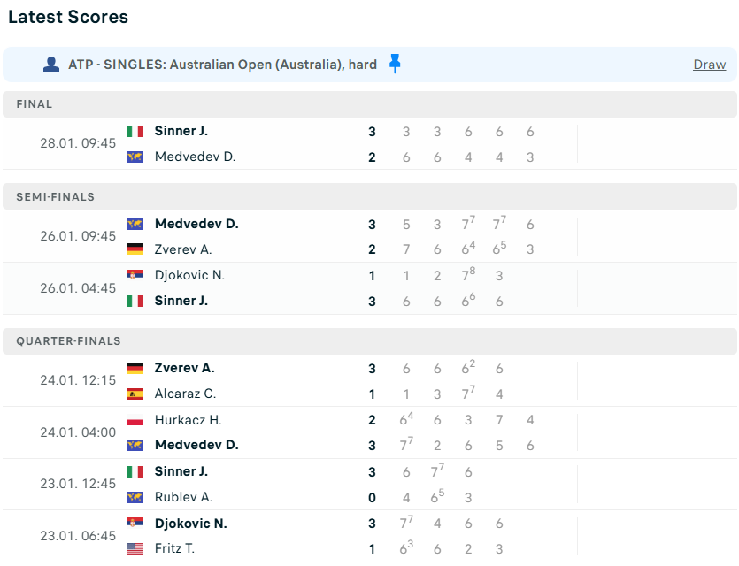
For every tournament, we will have a JSON file such as:
This is how the web pages is presented
{ year : [{ match-type : ,
player1: ,
player2: ,
points_p1: [ ] ,
points_p2: [ ] ,
winner: }, {…}, …, {…}],
year : [{ match-type : ,
player1: ,
player2: ,
points_p1: [ ] ,
points_p2: [ ] ,
winner: }, {…}, …, {…}],
…
}

Slide 4
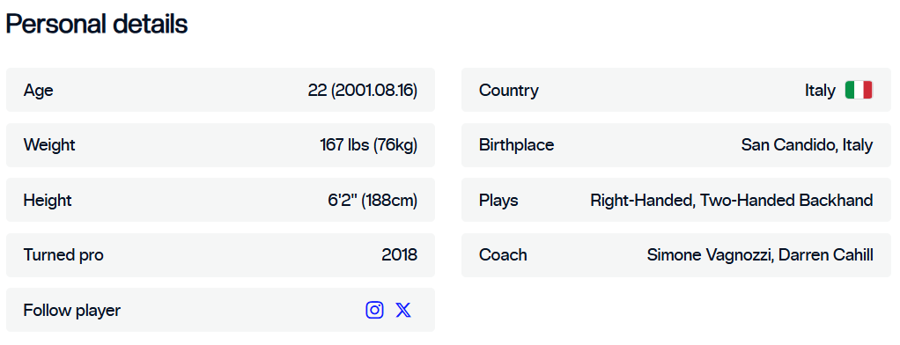
For every player, we will have a JSON file such as:
This is how the web pages is presented
{ name :
{ year of birth: ,
heigth: ,
weight: ,
turned pro: ,
hand: ,
backhand: },
name :
{ year of birth: ,
heigth: ,
weight: ,
turned pro: ,
hand: ,
backhand: },
{…}, …, {…}}

Slide 5
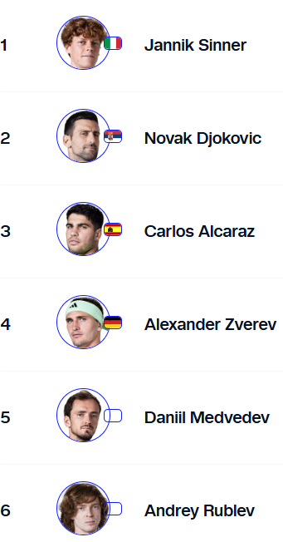
For every tournament, we will have a JSON file such as:
This is how the web pages is presented
{ year : [{ name : ,
rank: ,}, {…}, …, {…}],
year : [{ name : ,
rank: ,}, {…}, …, {…}],
…
}

Slide 6
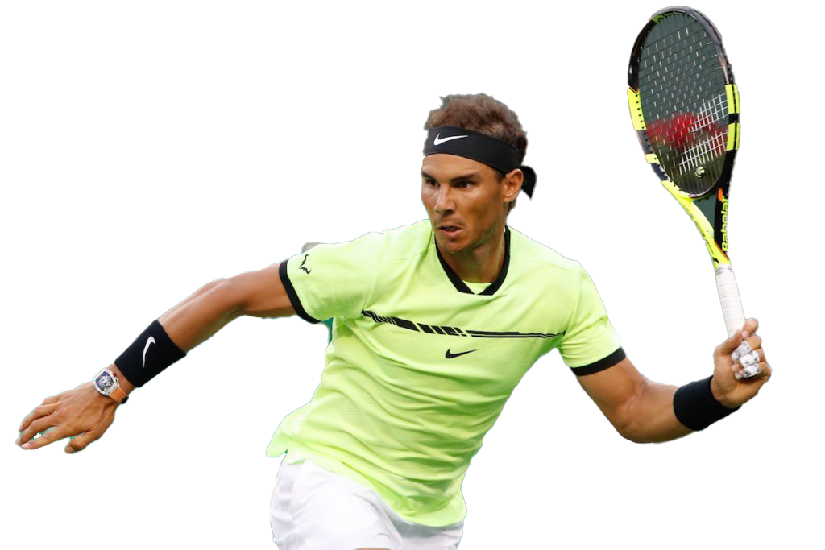
Conflicts
Main conflict arises between tennis players’ names:
VS
Name Surname
Surname N.
Some players have a second name
Some players have a composed surname
Examples: Alex de Minaur, Jann-Lennard Stuff, Juan Inacio Londer, Felix Auger-Aliassime
Resolution function in python, transforming into ‘Surname N.’

Slide 7
SCHEMA TRANSFORMATION & ENRICHMENT
For every tournament, every match should contain the rankings and the overviews of each player involved.
Rankings are takes by ranks file, matching through Name Formatted and year.
Information are taken by the overiview of every player, matching by the name
{‘match type’ : ‘Final’ ,
‘player1’ : { ‘Name’ : ‘Jannik Sinner’, ‘Rank’ : 4,
‘year of birth’ : 2001, ‘hand’ : ‘Right-Handed’,
‘backhand’ : ‘Two-Handed’, ‘turned pro’ : 2018,
‘Name Formatted’ : ‘Sinner J.’ },
‘player2’ : { … },
‘points_p1’ : [ … ],
‘points_p2’ : [ … ],
‘winner’ : ‘Jannik Sinner’,
‘year’ : 2024
}

Slide 8



THE DATABASE
Australian OPEN
Rolland Garros
Wimbledon
United States OPEN

Slide 9
Inside a collection…
{‘match type’ : ‘Final’ ,
‘player1’ : { ‘Name’ : ‘Jannik Sinner’, ‘Rank’ : 4,
‘year of birth’ : 2001, ‘hand’ : ‘Right-Handed’,
‘backhand’ : ‘Two-Handed’, ‘turned pro’ : 2018,
‘Name Formatted’ : ‘Sinner J.’ },
‘player2’ : { … },
‘points_p1’ : [ … ],
‘points_p2’ : [ … ],
‘winner’ : ‘Jannik Sinner’,
‘year’ : 2024
}

Slide 10


RESEARCH QUESTI NS:
How good young players performed during the last 10 years?
Who is the young player that performed the most upsets?

Slide 11
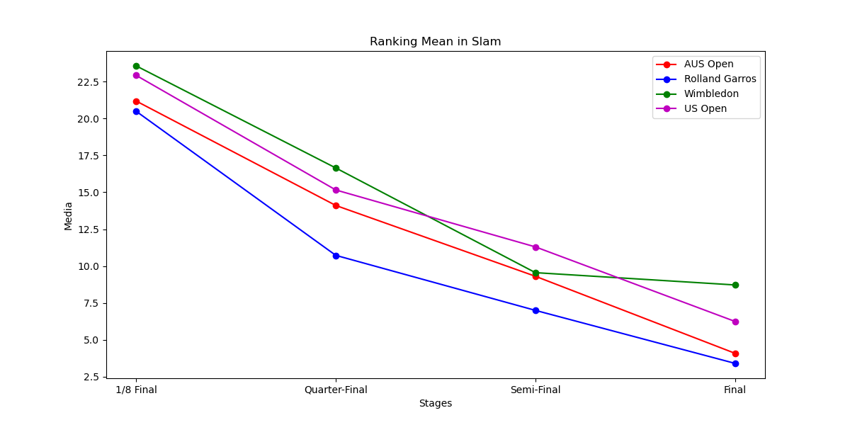
The higher the match the lower the ranking
Even tough it seems that in Wimbledon the mean of the finalists is significantly higher, this is due to the fact of Djokovic winning the Slam while being 21 in the ranking

Slide 12
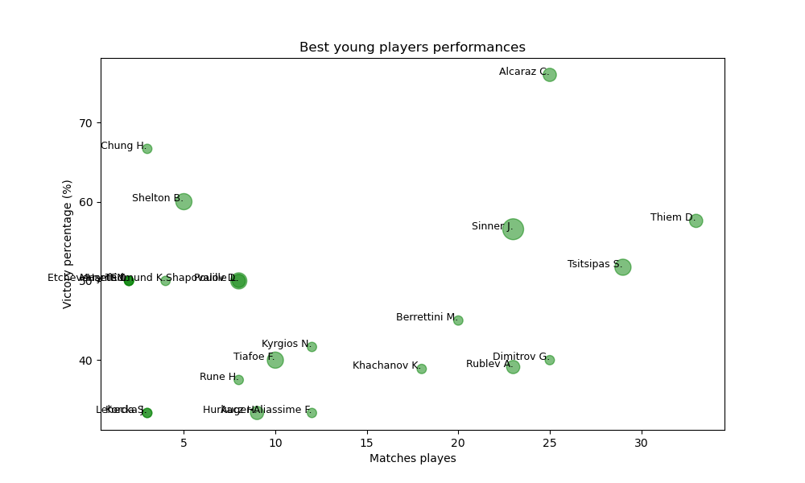
Best victory percentage overall in the last stages of a Slam
UPSETS: Winning against a higher-ranked player
Greatest upsetter
Best who still hasn’t a Slam title

Slide 13
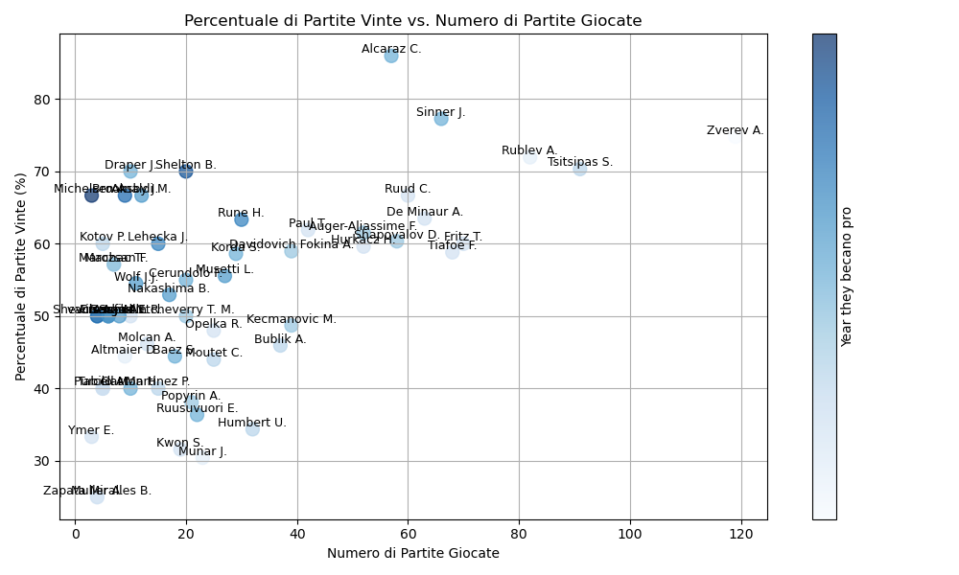
Some conclusions we can make..
Zverev played the most compared to others, however he turned pro before
Alcaraz has the best winning rate
The best young players (apart from Alcaraz and Sinner) to stand here are Rublev, Zverev, Tsitsipas, Ruud, De Minaur, Rune, and also Shelton

Slide 14
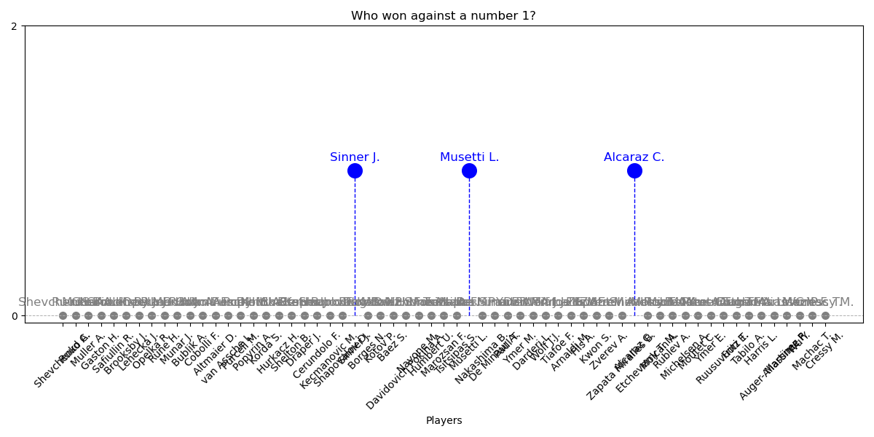
Who won against the best?
In SLAM tournaments is also harder for a young low-ranked player to defeat the greatest players, here is who succed in it:

